Slide 1
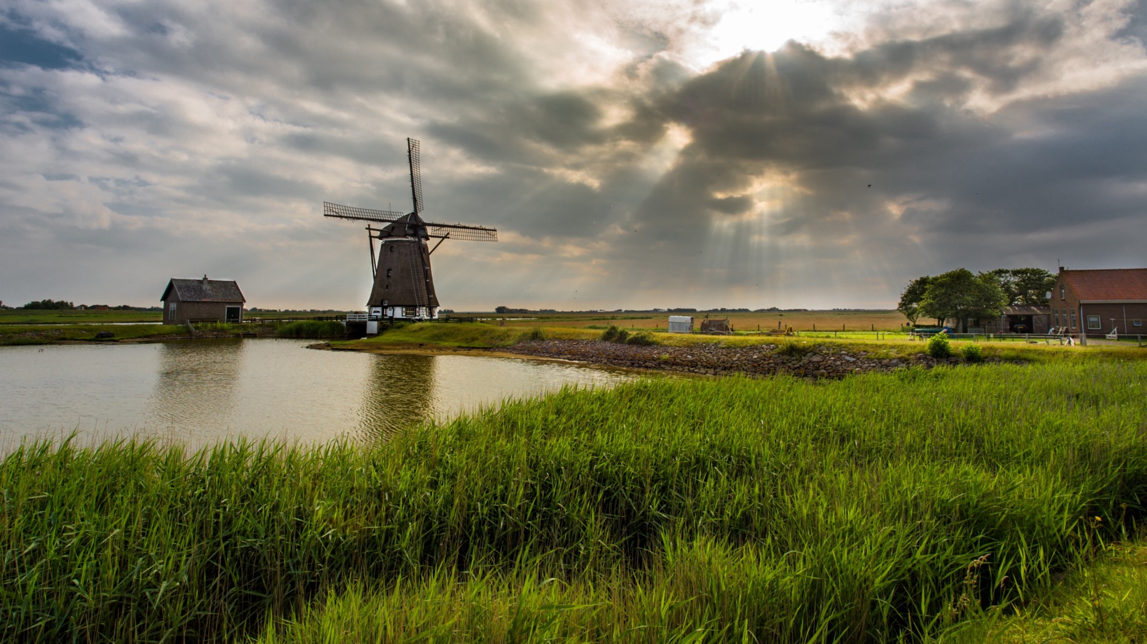

OGC API Features
WHY2025
Linda van den Brink / Pieter Bresters / Bart De Lathouwer

Slide 2
Schedule – 10:00 to 12:00
Brief introduction of the Spatial domain
From SOAP to REST
Start API coding in Node.js (using Express.js)
Standards (Building Blocks Part 1 - 5, CQL, Filter), Geo Enablement
Bruno
Interlude: Dutch API Design Rules
Client and coding using QGIS

Slide 3
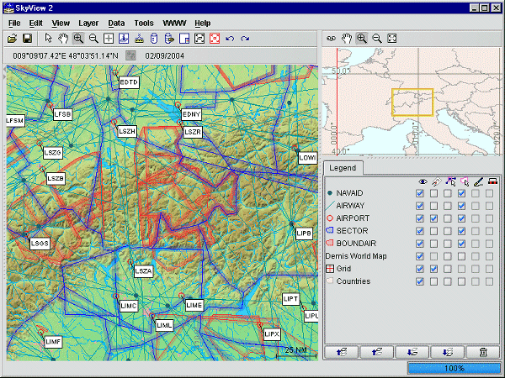
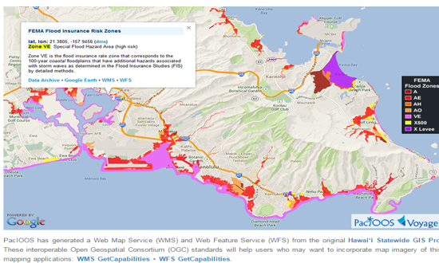
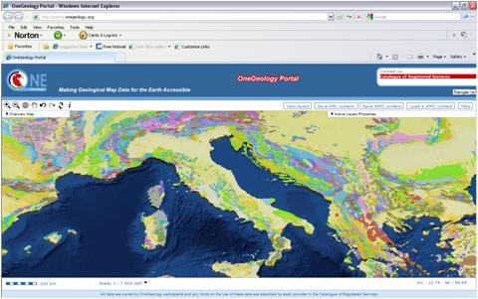
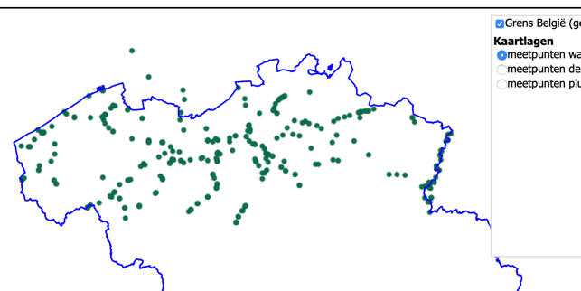
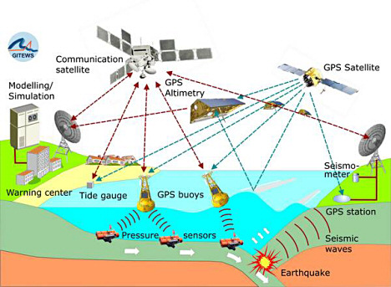
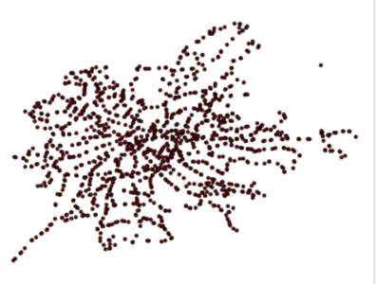
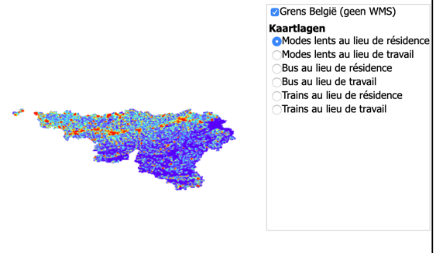
GEOSPATIAL? WHAT IS THAT?
OneGeology.Org
Eurocontrol
Aviation Flight Information / Safety
kmi
http://oos.soest.hawaii.edu/pacioos/voyager/news/2013/
DigitalGlobe
Waterinfo.be
Meteorology, Hydrology, Ocean Monitoring
SPW
Wallonie.be
WMS INPSIRE of the STIB
Irisnet.be
Source of statistics: GeoSeer spatial data search engine: https://geoseer.net
Notes:
3

Slide 4
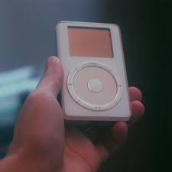



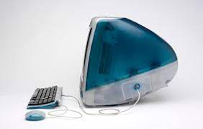


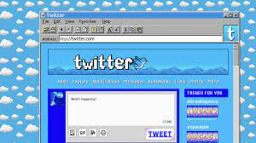
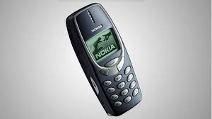

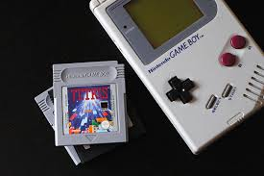
Why OGC APIs?
Let's go back in time... to the 1990s and Nillies
SOAP

Slide 5
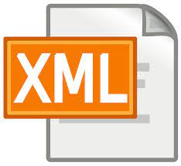
First, let's go back in time...
The web was seen as 'the future', but the web itself was still relatively immature (REST did not yet exist*).
The web was also XML-oriented
There were no clear patterns yet
(not as we know them today)
OGC was ahead of the pack with WMS
Major drivers: NGA and, somewhat later, INSPIRE
* Roy Fielding in 2000

Slide 6

The Good, the Bad and the Ugly (in hindsight)
Good:
OWS, Publish-Find-Bind, (Metadata)
Bad:
XML (GML*), SOAP
Ugly
Geospatial bubble!
OWS 2-step**

Slide 7
Why OGC APIs?
Easier than older generation services for web developers outside the geodomain
You don't need to be a GIS specialist to work with them
Also suitable for use within the geodomain
OpenAPI specification describes what they can do;
Works very intuitively.
Easier to find through search engines
Different types have the same structure and are therefore easier to combine.

Slide 8
Promoting the importance of OGC API
OGC APIs fit within government’s vision:
strengthen the geo-information infrastructure by making it more accessible to a wide group of users.
OGC APIs play a role in developments that are important to Geonovum, such as:
European data strategy
IBDS: Federated Data System
Common Ground
View of the Netherlands
Digital Twins
Data foundation
Notes:
European data strategy (e.g. HVDs from the Open Data Directive)
Federated Data System (cross-domain marketplace where supply and demand come together)
Common Ground (information science vision of the Association of Netherlands Municipalities)
Zicht op Nederland (Vision of the GI Council with programmes including: data foundation (cross-organisational, multifunctional
data landscape) and Digital Twins)

Slide 9
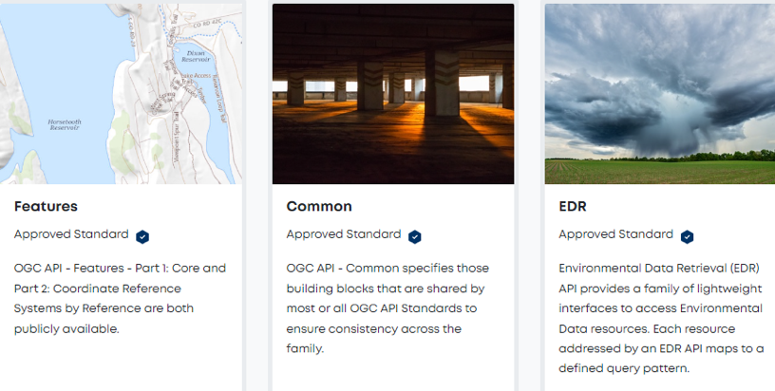
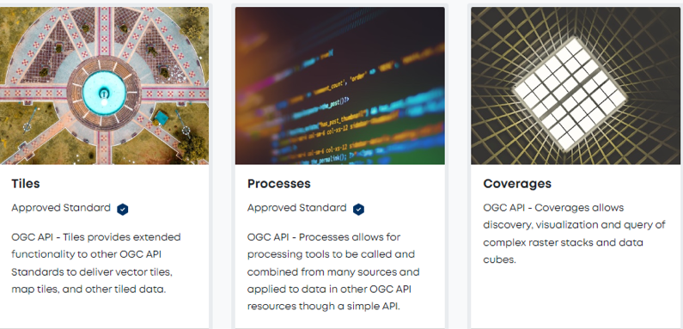
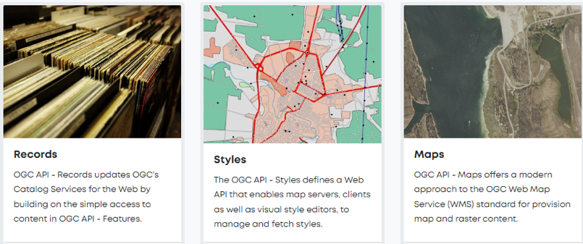
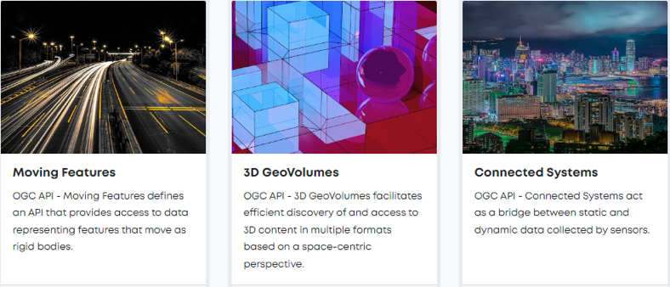
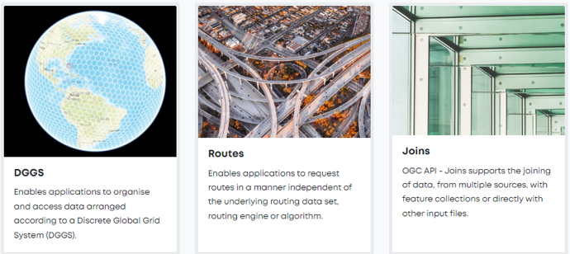
WFS > Features
WMST > Tiles
CSV > Records
WMS > Maps

Slide 10







Deployment model example – API building blocks
User: I want a list of traffic lights with certain characteristics
Tiles
User: I want to view maps on my smartphone
Features: Core
OGC API - Common
Data
Features: CQL
Maps
User: I want to download a map for a report.
Features: CRS
Coverages
User: a hurricane is coming, give me everything
Features: Transactions
EDR
User: I am looking for the locations of recent drilling in RD
User: I am flying to New York via this route, what is the weather like en route?
User: I want to change data about this object

Slide 11
OGC API Common – general rules
Consistent use of HTTP(S)
Consistent URI structure
Consistent use of parameters
There is always a landing page
Consistent method of offering JSON and HTML
Preferably API description in OpenAPI 3.0

Slide 12
OpenAPI
Open API Specification (OAS from Open API Initiative)
In Yaml or JSON and Swagger presentationhttps://editor.swagger.io/
Fixed fields https://spec.openapis.org/oas/v3.1.0#openapi-object
Info
Paths
collections (Get/Put)
conformance
Components
Schema
Parameters
Servers
Tags

Slide 13
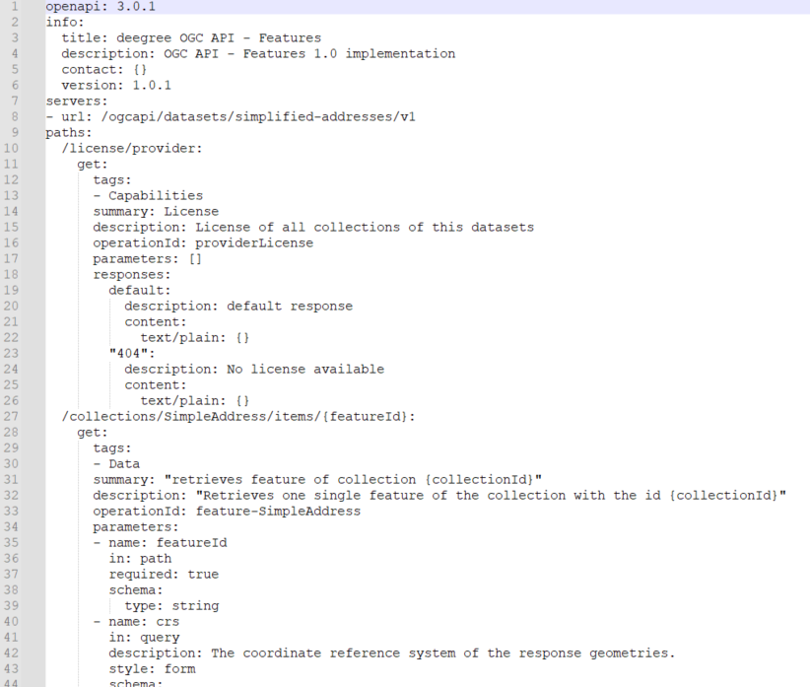
Example OAS
https://test.haleconnect.de/ogcapi/datasets/simplified-addresses/v1/openapi

Slide 14
A look at OGC API Features
GET / the landing page
GET /collections list of datasets key metadata
GET /collections/{collectionId} dataset key metadata
GET /collections/{collectionId}/items
retrieve items from a collection within a bounding box (or other simple filter)
client can request desired format via content negotiation, e.g. GeoJSON
pagination
GET /collections/{collectionId}/items/{featureId}
Request individual item
GET /collections/buildings/items?crs={crsuri}
Request in specific CRS
The default is CRS84

Slide 15

Code mode: ON
https://github.com/Geonovum/APIFeaturesForWHY2025

Slide 16

Code mode: ON
https://github.com/Geonovum/APIFeaturesForWHY2025

